Slide 1
Some Properties of Operators
Meeting #8
September 12, 2002
September 16, 2003
J.Y.Hung
ELEC 7500/6 State Variable Analysis

Slide 2
Operator Concept
Operator A maps vectors from space X to vectors in space Y
X
A
Y
J.Y.Hung
ELEC 7500/6 State Variable Analysis

Slide 3
Overview of Previous Lesson
Defined linear operator
Operator’s range and null space
Linear operators can be modeled as matrices multiplying vectors
Similarity transformation
J.Y.Hung
ELEC 7500/6 State Variable Analysis

Slide 4
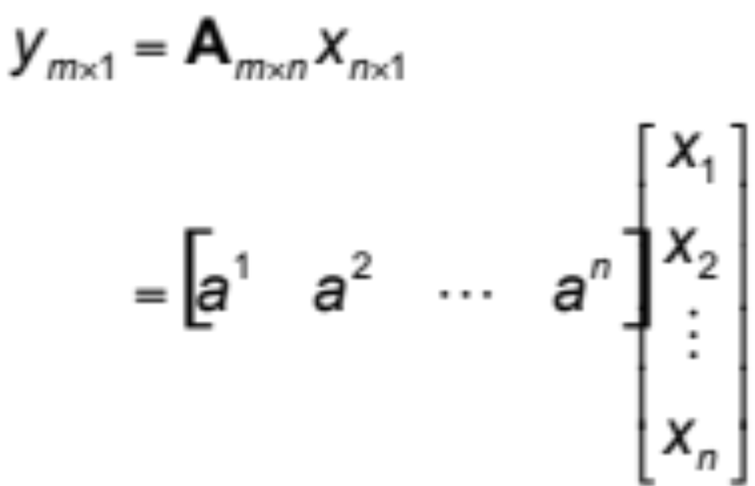
More on Range Space R(A)
Operator A, represented by
J.Y.Hung
ELEC 7500/6 State Variable Analysis

Slide 5
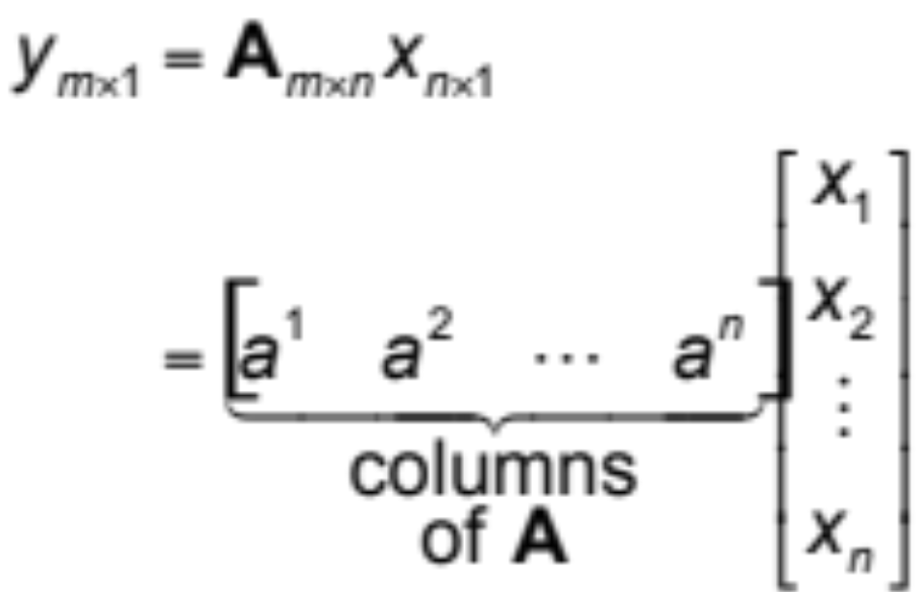
More on Range Space R(A)
y: linear combination of columns of A
J.Y.Hung
ELEC 7500/6 State Variable Analysis

Slide 6
More on Range Space R(A)
Columns of A span R(A)
J.Y.Hung
ELEC 7500/6 State Variable Analysis

Slide 7

More on Range Space R(A)
dim(A) = # lin. indep. columns of A
also called rank of A
J.Y.Hung
ELEC 7500/6 State Variable Analysis

Slide 8
More on Null Space N(A)
Null space satisfies
A_{m×n}x_{n×1} = 0_{m×1}
J.Y.Hung
ELEC 7500/6 State Variable Analysis

Slide 9
Lesson Goals
Vector representation in a basis
Eigenvalues & eigenvectors
Transformations to "modal" form
Reference: Brogan, Chapter 7.1-7.4
J.Y.Hung
ELEC 7500/6 State Variable Analysis

Slide 10
Vector representation problem
Given vector x and basis set {e^{i}}
x = α₁e¹ + … + α_{n}e^{n}
Find the scalars α_{i}
J.Y.Hung
ELEC 7500/6 State Variable Analysis

Slide 11
Using inner products
Consider inner products of {e^{i}} with x
<e¹,x> = α₁<e¹,e¹> + … + α_{n}<e¹,e^{n}>
J.Y.Hung
ELEC 7500/6 State Variable Analysis

Slide 12
Using inner products
Consider inner products of {e^{i}} with x
<e¹,x> = α₁<e¹,e¹> + … + α_{n}<e¹,e^{n}>
:
<e^{n},x> = α₁<e^{n},e¹> + … + α_{n}<e^{n},e^{n}>
J.Y.Hung
ELEC 7500/6 State Variable Analysis

Slide 13
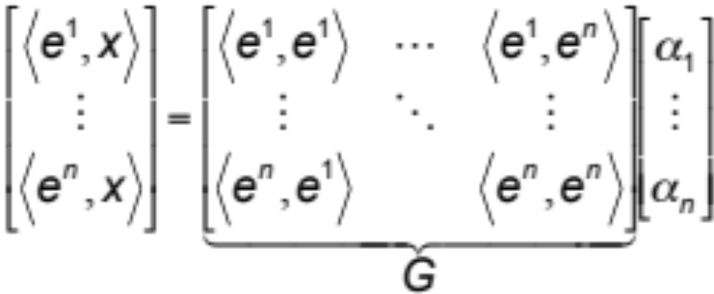
In matrix-vector notation
J.Y.Hung
ELEC 7500/6 State Variable Analysis

Slide 14
In matrix-vector notation
G is called the Grammian matrix
J.Y.Hung
ELEC 7500/6 State Variable Analysis

Slide 15
Notes on the Grammian
symmetric for real-valued {e^{i}}
J.Y.Hung
ELEC 7500/6 State Variable Analysis

Slide 16
Notes on the Grammian
symmetric for real-valued {e^{i}}
In general, G = G*
  complex conjugate transpose
J.Y.Hung
ELEC 7500/6 State Variable Analysis

Slide 17
Notes on the Grammian
symmetric for real-valued {e^{i}}
In general, G = G*
  complex conjugate transpose
G⁻¹ exists if {e^{i}} are lin. independent
  useful way to test for lin. dependence
J.Y.Hung
ELEC 7500/6 State Variable Analysis

Slide 18
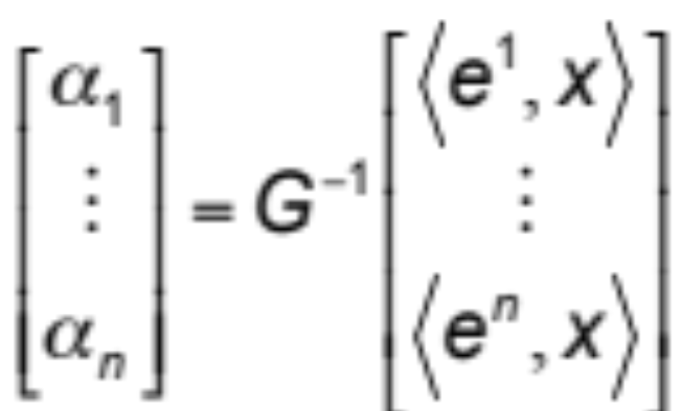
Vector representation solution
J.Y.Hung
ELEC 7500/6 State Variable Analysis

Slide 19
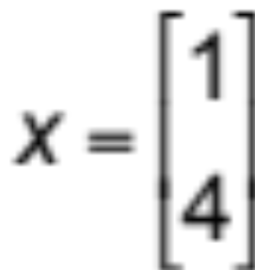
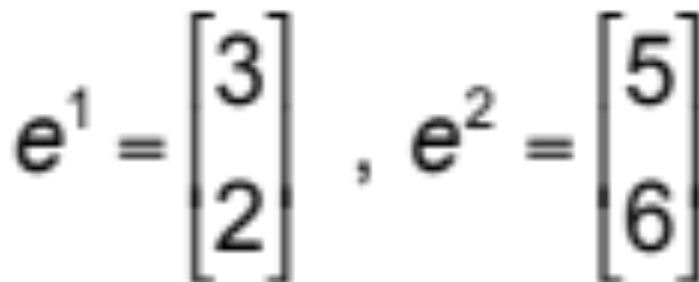
Example (1)
J.Y.Hung
ELEC 7500/6 State Variable Analysis

Slide 20
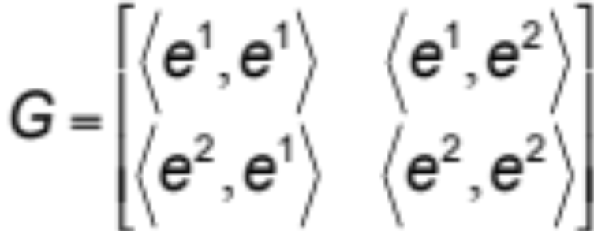
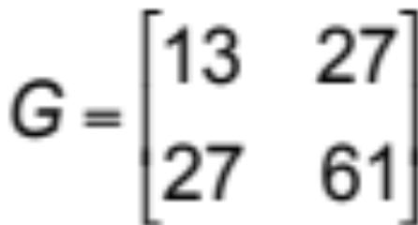
Example (2)
Grammian, G
J.Y.Hung
ELEC 7500/6 State Variable Analysis

Slide 21
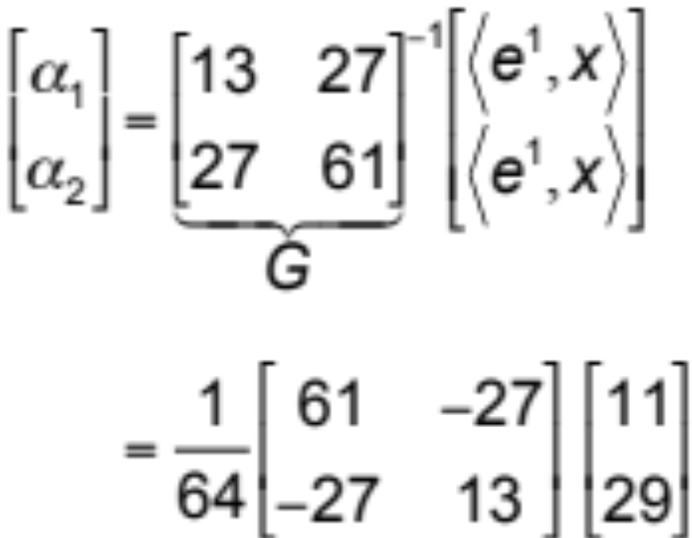
Example (3)
Solution
J.Y.Hung
ELEC 7500/6 State Variable Analysis

Slide 22
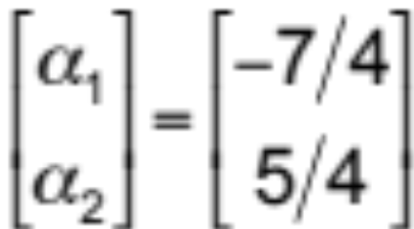
Example (3)
Solution
J.Y.Hung
ELEC 7500/6 State Variable Analysis

Slide 23
Example (4)
Matlab solution
x=[1 4]' % define x
e1=[3 2]' % and basis vectors
e2=[5 6]'
G=[e1'*e1 e1'*e2; e2'*e1 e2'*e2]
alpha=G\[e1'*x e2'*x]' % solved!
J.Y.Hung
ELEC 7500/6 State Variable Analysis

Slide 24
Recall
Linear operator A
"stretches and rotates" vectors
y
A
y=Ax
x
J.Y.Hung
ELEC 7500/6 State Variable Analysis

Slide 25
Special directions
Q: Are there vectors that are directionally invariant under A?
y=Ax
x
y
A
J.Y.Hung
ELEC 7500/6 State Variable Analysis

Slide 26
Special directions
Such vectors v would satisfy
vs = Av
vs=Av
v
vs
A
J.Y.Hung
ELEC 7500/6 State Variable Analysis

Slide 27
Eigenvectors & Eigenvalues
Such vectors v would satisfy
vs = Av
v : eigenvector
  German for "characteristic" vector
s : eigenvalue
  a scalar (scales length of v)
J.Y.Hung
ELEC 7500/6 State Variable Analysis

Slide 28
Characteristic equation
vs = Av
is the same as
(sI – A)v = 0
J.Y.Hung
ELEC 7500/6 State Variable Analysis

Slide 29
Characteristic equation
vs = Av
is the same as
(sI – A)v = 0
and has nontrivial solution only if
|sI – A| = 0
has solutions.
J.Y.Hung
ELEC 7500/6 State Variable Analysis

Slide 30
Some Notes
rank of A
  size of largest non-zero determinant formed from A
nonsingular A_{n×n}: rank(A) = n
degeneracy (q) or nullity of A
  q = n – rank(A)
  rank of the null space of A
J.Y.Hung
ELEC 7500/6 State Variable Analysis

Slide 31
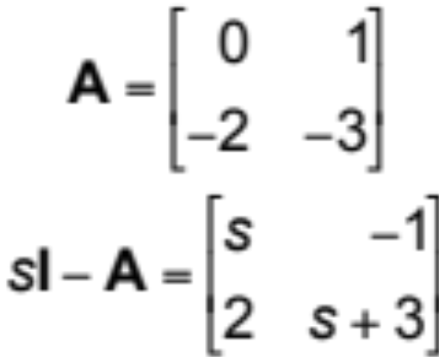
Example (step 1)
Eigenvalues satisfy |sI – A| = 0
J.Y.Hung
ELEC 7500/6 State Variable Analysis

Slide 32
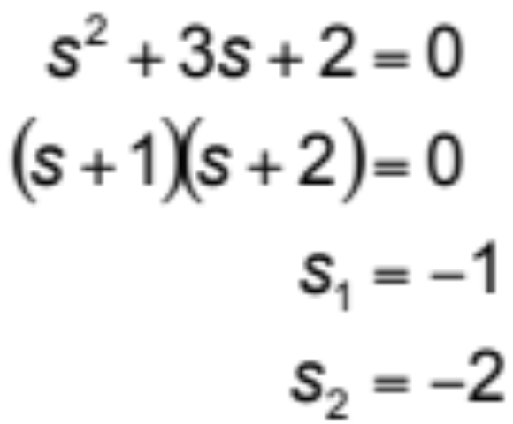
Example (step 2)
Two unique eigenvalues…
J.Y.Hung
ELEC 7500/6 State Variable Analysis

Slide 33
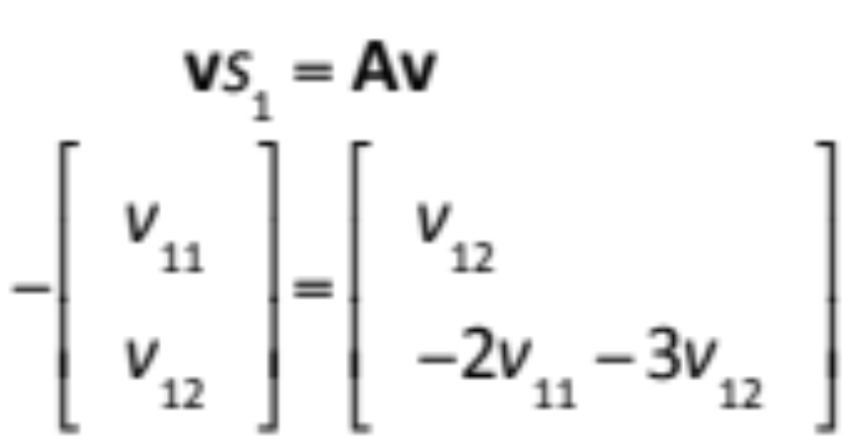
Example (step 3)
Finding eigenvectors
Note: Rank of the problem = 1
J.Y.Hung
ELEC 7500/6 State Variable Analysis

Slide 34
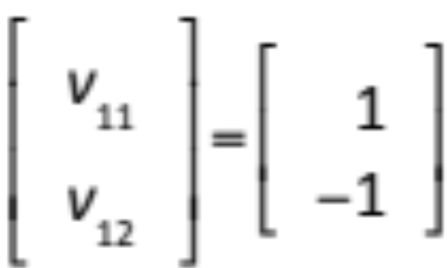
Example (step 3)
Finding eigenvectors
Note: Rank of the problem = 1
J.Y.Hung
ELEC 7500/6 State Variable Analysis

Slide 35
Example (computer tool)
Matlab solution
A=[0 1; -2 -3] % matrix A
[m,s]=eig(A) % solved!
J.Y.Hung
ELEC 7500/6 State Variable Analysis

Slide 36
Example (Matlab results)
      m =
      0.7071 -0.4472
      -0.7071 0.8944
      s =
      -1 0
      0 -2
J.Y.Hung
ELEC 7500/6 State Variable Analysis

Slide 37
Transformation to Modal Form
Modal matrix M = [v₁ … v_{n}]
  columns are eigenvectors of A
Eigenvalue matrix S = diag[s₁ … s_{n}]
Then
MS=AM
S=M⁻¹AM or A=MSM⁻¹
J.Y.Hung
ELEC 7500/6 State Variable Analysis

Slide 38
Notes on Matrix S
Eigenvalues of A on the diagonal
Diagonal S is not always possible
If diagonal, simplifies analysis
  dynamics are uncoupled
J.Y.Hung
ELEC 7500/6 State Variable Analysis

Slide 39
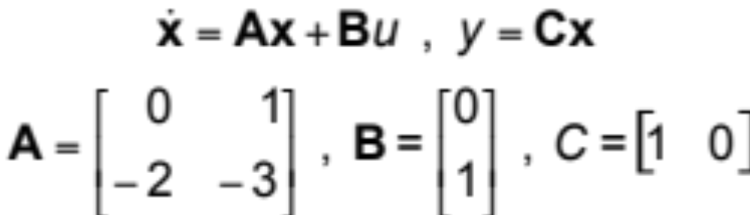
Application to Modeling
Consider
  controllable canonic form
J.Y.Hung
ELEC 7500/6 State Variable Analysis

Slide 40
Simulation Model (in x)
u
1
s
1
s
y
Σ
–
–3
–2
J.Y.Hung
ELEC 7500/6 State Variable Analysis

Slide 41
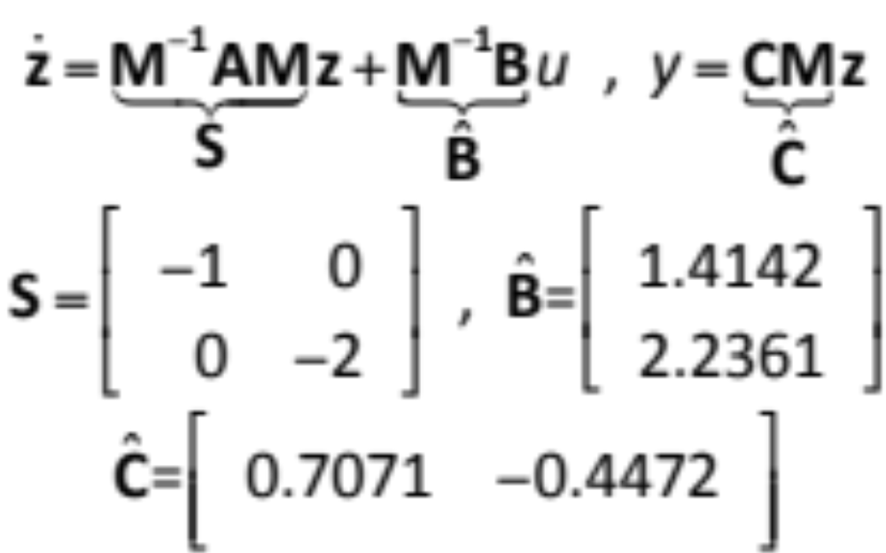
Model in Modal Form
(x=Mz)
J.Y.Hung
ELEC 7500/6 State Variable Analysis

Slide 42
Simulation Model (in z)
u
1
s
Σ
–
y
Σ
1
s
–
Σ
–2
J.Y.Hung
ELEC 7500/6 State Variable Analysis

Slide 43
Notes on the Modal Model
Gains of input and output matrices are combined in each channel
Compare transfer functions for:
  controllable canonic form
  parallel (modal) form
J.Y.Hung
ELEC 7500/6 State Variable Analysis

Slide 44
Some Issues
Eigenvalues may be repeated
Diagonal S might not be possible
General case: the Jordan form
  "block" diagonal structure
  Diagonal S is a special case
Download notes: eigen.pdf
J.Y.Hung
ELEC 7500/6 State Variable Analysis

Slide 45
Homework
Read additional notes in file "eigen.pdf"
J.Y.Hung
ELEC 7500/6 State Variable Analysis

